Slide 1

Design Patterns
LESSON 2
BEHAVIORAL PATTERNS

Slide 2
Classification
Creational patterns provide various object creation mechanisms, which increase flexibility and reuse of existing code.
Singleton, Factory Method, Abstract Factory, Builder, Prototype
Structural patterns explain how to assemble objects and classes into larger structures while keeping these structures flexible and efficient.
Adapter, Bridge, Composite, Decorator, Façade, Flyweight, Proxy
Behavioral patterns handle how objects interact: communication, dependencies, isolation.
Chain of responsibility, Command, Iterator, Mediator, Memento, Observer, State, Strategy, Template Method, Visitor
Creational Patterns
Structural Patterns
Behavioral Patterns
Notes:
Creational = mecanisme de creare a obiectele pentru a oferi flexibilitate si reutilizare a codului
Structural = asamblarea obiectelor si a claselor, integrarea lor structuri mai largi, lasand totusi flexibilitate. Aici o sa fie mai grele exemplele, pentru ca nu o sa lucram pe structuri largi
Behavioral = se refera mai mult la algoritmi si asignarea responsabilitatilor intre obiecte

Slide 3
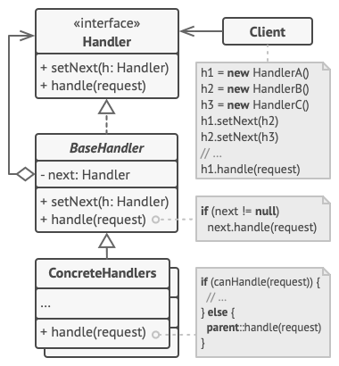
Chain of responsibility
Problem: sequential logic that needs to be executes in a particular logic, a lot of guard conditions (if something, then stop execution)
Solution: transform separate logic to handler objects, each handler in the chain can pass further to another handler, can stop the execution or can process the request

Slide 4
Chain of responsibility in a few words + examples from open-source projects
Unique handlers, each handler knows about its successor
Can become difficult if it’s a long chain of handlers, you can have performance issues
Hierarchical structure, but a handler is not aware of the whole hierarchy, it just knows the next handler
There might be the risk of leaving a request unprocessed
.NET: HTTP pipeline, Microsoft.Practices.EnterpriseLibrary.Logging.Logger
Spring Security filter chain
java.util.logging.Logger#log()
javax.servlet.Filter#doFilter()
NodeJS: express middlewares https://expressjs.com/en/guide/using-middleware.html

Slide 5
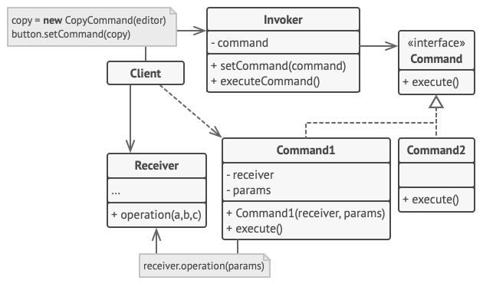
Command
Problem: Components coupled too tight with business logic
Solution: Create intermediary objects that are able to handle commands, separate invocation from performing
Notes:
Separate invocation from performing. You delegate work to other objects
Real world example light and switch
Receiver = the one who receives the command
Invoker = the one who sends the command
The client does not execute the command directly on the receiver, but it sends it to the Command through the Invoker.
Macro command = it receives multiple receivers in the constructor
On short, the implementation forces you to have a method in all commands, “execute”, “run”, and you have the receiver object and the parameters available, you just have to call the given command
You can use for operation Java reflection or C++ pointers

Slide 6
Command in a few words + examples from open-source projects
Encapsulate in an object all the data required to perform an action (command)
Sender is decoupled from the processor => MAINTAINABILITY
Together with Memento you can implement undo functionality
Macro command = it receives multiple receivers in the constructor
Java: java.lang.Runnable, javax.swing.Action
C#: System.Windows.RoutedEventArgs
Extra docs: https://sourcemaking.com/design_patterns/command

Slide 7
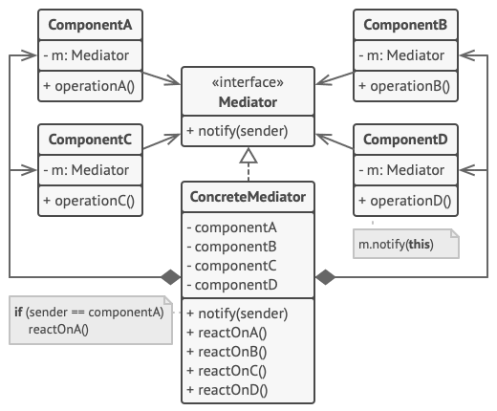
Mediator
Problem: a lot of dependencies between objects, “spaghetti code”
Solution: create a mediator that is responsible to handle requests and react with needed updates on other components
Notes:
Mediator eliminates communication between objects. It forces them to communicate through a mediator.
As the dictionary says, it occupies a middle position.
Common use cases: chat application, UI forms, think of a login/register form, or create/edit something form.
The pitfall here is to create the so-called God object, knows too much, does too much
Only the mediator knows about colleagues/components, they don’t know about each other.
The mediator is responsible of defining the interaction between components.
The main advantages are that it minimize inheritance and it has loose coupling.

Slide 8
Mediator in a few words + examples from open-source projects
Eliminate dependencies between a set of system components
Defines interaction between components
Components are very often called “colleagues”
Classic pitfall: God object
C#: System.Threading.Timer
Java:
scheduleXXX() methods of java.util.Timer
scheduleXXX() methods of java.util.concurrent.ScheduledExecutorService
java.lang.reflect.Method#invoke()
Mediator.js: https://www.npmjs.com/package/mediator-js

Slide 9
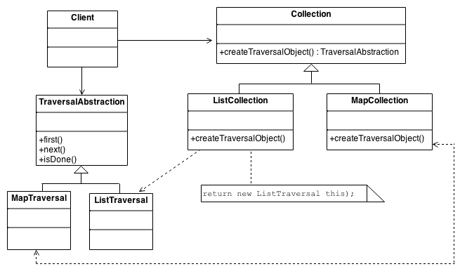
Iterator
Problem: the need for a unified way to traverse any data structures, regardless of its underlying representation
Solution: defined standard traversal protocol in order to decouple your data from the algorithms
Notes:
We use iterators a lot in out daily lives. How we look into nature with our eyes, how a secretary knows all the files, how we decide to get dressed, how we switch between TV channels.
Iterator can traverse Composites, in your implementations.
It can be slower

Slide 10
Iterator in a few words + examples from open-source projects
Suitable for complex data structure
Fail fast vs fail safe
Does not expose collection structure, so no index, like in a for loop
Can also be implemented for security reasons
C#: System.Collections.Ienumerable, System.Data.IDataReader
Java: java.util.Iterator
foreach (in several languages)
Generators (Python and JavaScript)

Slide 11
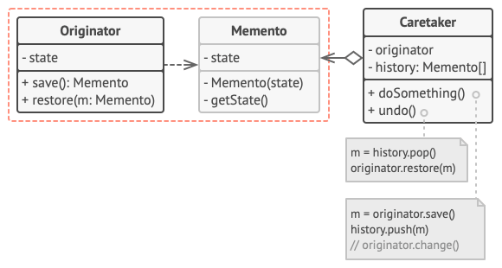
Memento
Problem: need to restore previous states of an object (undo, rollback operations)
Solution:
Memento – immutable, nested class (there are other implementations as well)
Caretaker – decides when and what to restore
Originator – saves its state to memento

Slide 12
Memento in a few words + examples from open-source projects
Used to restore a previous state
Memento must be immutable, so no setter methods
Classic use case: undo functionality
Several implementations: nested classes, interface (find more details here)
Java:
java.io.Serializable
javax.faces.component.StateHolder
java.util.Date
C#: Sytem.Runtime.Serialization.Iserializable

Slide 13
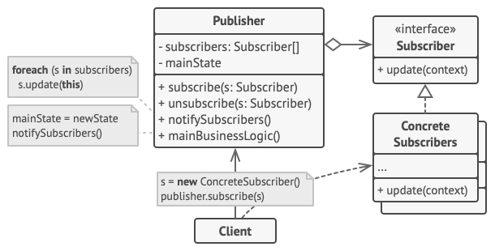
Observer
Problem: need to dynamically react on some events happening in the app, need some objects to follow other objects for a limited time or in some specific cases
Solution: identify the object that is observable (observable/publisher/subject), maintain a list of objects depending on it (observers/subscribers) that need to be automatically notified about any changes in the state

Slide 14
Observer in a few words + examples from open-source projects
Java: java.util.EventListener
C#: Sytem.IObservable
Android: https://developer.android.com/reference/android/database/DataSetObservable
jQuery: jquery.on(), jquery.trigger(), jquery.off()
React Redux: https://react-redux.js.org/
RxJS: https://rossbulat.medium.com/rxjs-a-simple-introduction-32fb48f52a67
Tip for presentation: compare with Publish/Subscribe pattern
All subscribers need to follow the same interface, so that the Subject/Publisher can interact uniformly with them
Usually, 1 to many relationship (1 observable with many subscribers)
Change subscribers at runtime
Can make debugging difficult, can lead to unexpected updates

